Slide 1


ABC Call Volume Trend Analysis

Slide 2






Slide 3

Average Call Duration:

Slide 4

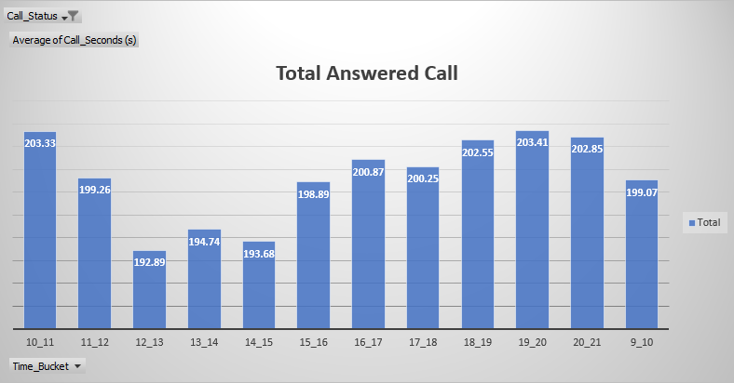
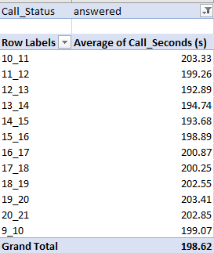
Average Call Duration:
Determine the average duration of all incoming calls received by agents. This should be calculated for each time bucket.

Slide 5
Call Volume Analysis:

Slide 6
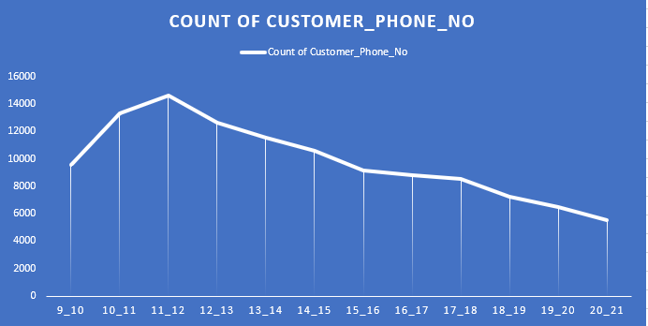
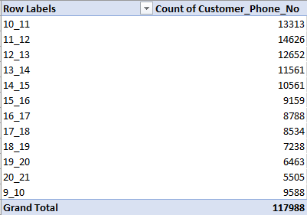
Call Volume Analysis:
Visualize the total number of calls received. This should be represented as a graph or chart showing the number of calls against time. Time should be represented in buckets (e.g., 1-2, 2-3, etc.).

Slide 7

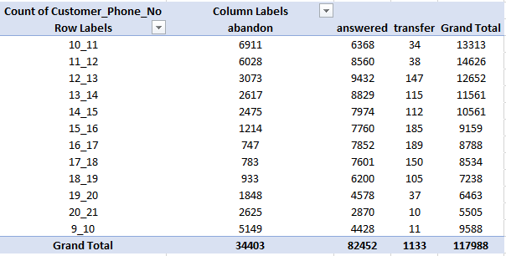
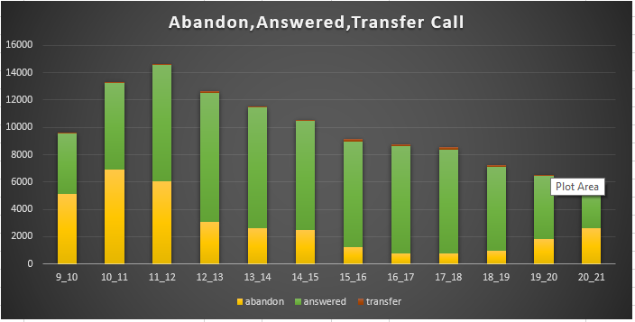

Slide 8
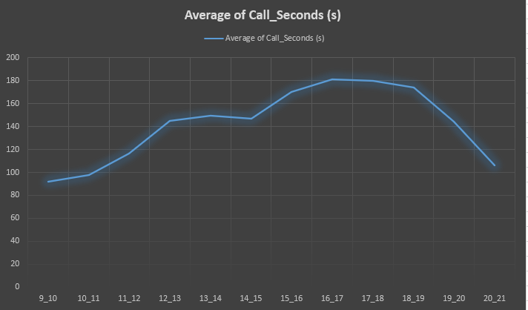
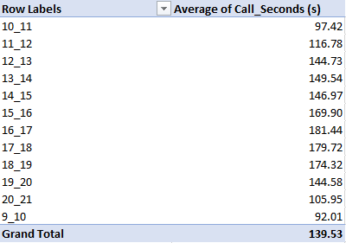

Slide 9
Manpower Planning:

Slide 10
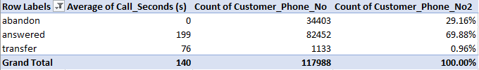
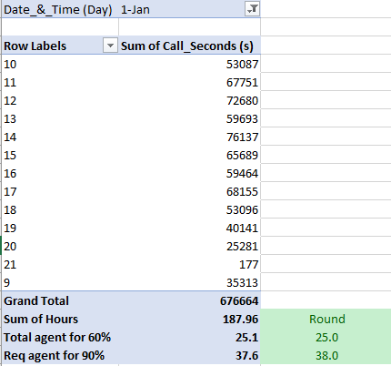
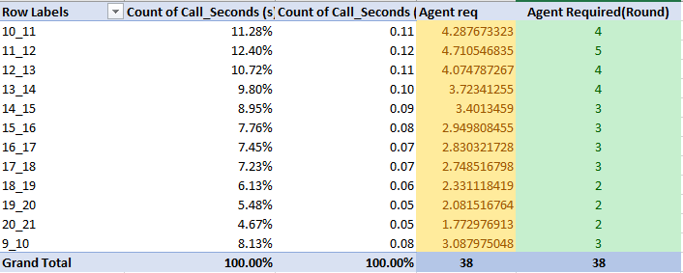
Manpower Planning:
The current rate of abandoned calls is approximately 30%. Propose a plan for manpower allocation during each time bucket (from 9 am to 9 pm) to reduce the abandon rate to 10%. In other words, you need to calculate the minimum number of agents required in each time bucket to ensure that at least 90 out of 100 calls are answered.

Slide 11
Night Shift Manpower Planning:

Slide 12
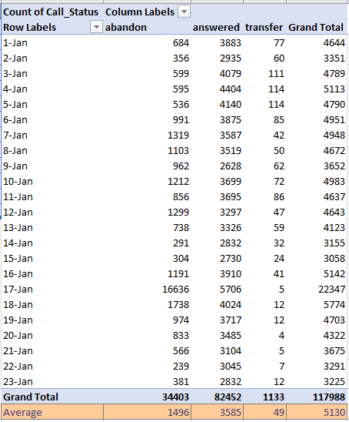
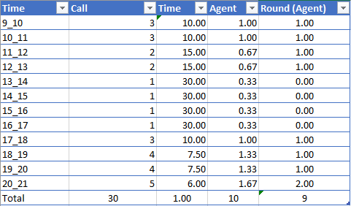
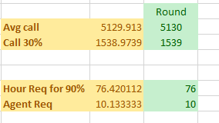
Night Shift Manpower Planning:
Customers also call ABC Insurance Company at night but don't get an answer because there are no agents available. This creates a poor customer experience. Assume that for every 100 calls that customers make between 9 am and 9 pm, they also make 30 calls at night between 9 pm and 9 am. The distribution of these 30 calls is as follows:

Slide 13
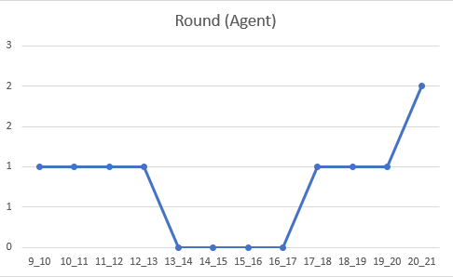
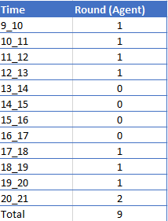

Slide 14
Conclusion
Project Description : The project focuses on enhancing customer experience (CX) by analyzing inbound calls within a company. Inbound calls are a crucial touchpoint where customers seek assistance or information, making it essential to optimize this process. By leveraging data analytics techniques, we aim to extract insights from inbound call data to improve customer satisfaction and operational efficiency.
Approach : Data Collection and Preprocessing , Exploratory Data Analysis (EDA),Call Routing Optimization , Queue Management , Agent Training and Performance Monitoring , Continuous Improvement.
Tech-Stack Used : Microsoft Excel 2022
Insights:
Call Volume Trends: Identify any patterns or trends in call volume over the 23-day period. This could include daily or weekly fluctuations, as well as any significant changes over time.
Peak Call Times: Determine the peak call times when the highest volume of calls is received. Insights into peak times can inform staffing decisions and resource allocation to ensure prompt customer service.
Advertising Effectiveness : if advertising data is available, assess the correlation between advertising efforts and call volume. Identify which advertising channels are driving the most inquiries and optimize advertising spend accordingly.
Operational Efficiency: Evaluate the efficiency of CX operations based on metrics such as queue times, call durations, and call statuses (answered, abandoned, transferred). Identify areas for improvement to streamline processes and enhance customer satisfaction.
Recommendations: Based on the insights derived from the analysis, provide actionable recommendations for optimizing inbound calling operations and improving overall customer experience. These recommendations should be tailored to address specific pain points and capitalize on opportunities identified during the analysis.
Result : Overall, the results of the project aim to provide actionable insights and recommendations for improving the inbound calling operations and overall customer experience strategy of the company. These insights can inform decision-making and drive positive changes to enhance customer satisfaction and business success.

Slide 15
THANK YOU
Suraj kumar

